Slide 1

Web development
Success Outcomes:
Students will be able to describe what HTML is and its role in web development.
Students will learn basic HTML tags
Students will learn how to identify some tags used in an actual website’s source code
Students will learn some basic CSS skills
Students will learn to produce their own websites
TOPIC: Web design and development.
Lesson 3
The Grammar Way: Resilience

Slide 2
Styles & CSS files
Success Outcomes:
Students will be able to describe what HTML is and its role in web development.
Students will learn basic HTML tags
Students will learn how to identify some tags used in an actual website’s source code
Students will learn some basic CSS skills
Students will learn to produce their own websites
TOPIC: Web design and development.
The Grammar Way: Resilience

Slide 3
Styling
Success Outcomes:
Students will be able to describe what HTML is and its role in web development.
Students will learn basic HTML tags
Students will learn how to identify some tags used in an actual website’s source code
Students will learn some basic CSS skills
Students will learn to produce their own websites
TOPIC: Web design and development.
Styling
Styling is how the content should look. For instance the colour of the text, the background or the font.
The Grammar Way: Resilience

Slide 4
What will be covered
Success Outcomes:
Students will be able to describe what HTML is and its role in web development.
Students will learn basic HTML tags
Students will learn how to identify some tags used in an actual website’s source code
Students will learn some basic CSS skills
Students will learn to produce their own websites
TOPIC: Web design and development.
How to add different types of Styles
Some positional styles
Some text and colour styles
The Grammar Way: Resilience

Slide 5
Types of Styling
Success Outcomes:
Students will be able to describe what HTML is and its role in web development.
Students will learn basic HTML tags
Students will learn how to identify some tags used in an actual website’s source code
Students will learn some basic CSS skills
Students will learn to produce their own websites
TOPIC: Web design and development.
In-line
Internal
External CSS sheet
The Grammar Way: Resilience

Slide 6
In-line styling
Success Outcomes:
Students will be able to describe what HTML is and its role in web development.
Students will learn basic HTML tags
Students will learn how to identify some tags used in an actual website’s source code
Students will learn some basic CSS skills
Students will learn to produce their own websites
TOPIC: Web design and development.
In-line i.e. using the style attribute.
<Opening-tag style= “property: value”>
<h1 style="color:blue;">This is a Blue Heading</h1>
The Grammar Way: Resilience

Slide 7
Styling in the head:
Success Outcomes:
Students will be able to describe what HTML is and its role in web development.
Students will learn basic HTML tags
Students will learn how to identify some tags used in an actual website’s source code
Students will learn some basic CSS skills
Students will learn to produce their own websites
TOPIC: Web design and development.
Internal i.e. in the “head” using the <style> tags
<head>
<title>
Sohaib
</title>
<style>
h1{
float: right;
}
</style>
</head>

Slide 8
Styling using CSS
Success Outcomes:
Students will be able to describe what HTML is and its role in web development.
Students will learn basic HTML tags
Students will learn how to identify some tags used in an actual website’s source code
Students will learn some basic CSS skills
Students will learn to produce their own websites
TOPIC: Web design and development.
CSS sheets: CSS stands for Cascading Style Sheets. External CSS are stored in CSS sheets i.e. using the .css extention. The syntax is the same as styling in the head, between the style tags(minus the style tags).
The Grammar Way: Resilience

Slide 9
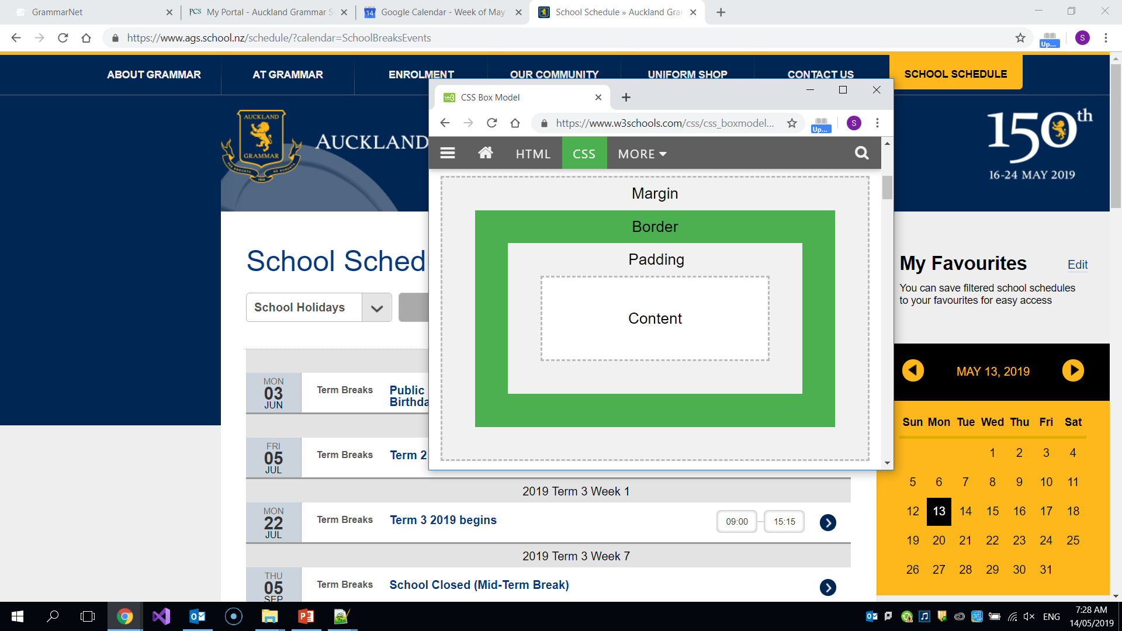
Positioning Styles: CSS Box Model
Success Outcomes:
Students will be able to describe what HTML is and its role in web development.
Students will learn basic HTML tags
Students will learn how to identify some tags used in an actual website’s source code
Students will learn some basic CSS skills
Students will learn to produce their own websites
TOPIC: Web design and development.
All HTML elements can be considered as boxes. In CSS, the term "box model" is used when talking about design and layout.
The CSS box model is essentially a box that wraps around every HTML element. It consists of: margins, borders, padding, and the actual content.
The Grammar Way: Resilience

Slide 10
Example:
Success Outcomes:
Students will be able to describe what HTML is and its role in web development.
Students will learn basic HTML tags
Students will learn how to identify some tags used in an actual website’s source code
Students will learn some basic CSS skills
Students will learn to produce their own websites
TOPIC: Web design and development.
body{
padding: 10px;
margin: 10px;
border: solid;
border-width: 10px;
}
The Grammar Way: Resilience

Slide 11
More Positioning Styles: The float Property
Success Outcomes:
Students will be able to describe what HTML is and its role in web development.
Students will learn basic HTML tags
Students will learn how to identify some tags used in an actual website’s source code
Students will learn some basic CSS skills
Students will learn to produce their own websites
TOPIC: Web design and development.
The float property is used for positioning and formatting content e.g. let an image float left to the text in a container. The float property can have one of the following values:
left - The element floats to the left of its container.
right- The element floats to the right of its container.
none - The element does not float (will be displayed just where it occurs in the text). This is default.
inherit - The element inherits the float value of its parent.
The Grammar Way: Resilience

Slide 12
The display property:
Success Outcomes:
Students will be able to describe what HTML is and its role in web development.
Students will learn basic HTML tags
Students will learn how to identify some tags used in an actual website’s source code
Students will learn some basic CSS skills
Students will learn to produce their own websites
TOPIC: Web design and development.
The display property specifies the display behavior (the type of rendering box) of an element. Some common ones are:
block: Displays an element as a block element (like <p>). It starts on a new line, and takes up the whole width.
list-item: Let the element behave like a <li> element.
Inline: Displays an element as an inline element e.g. you can get two <p> elements to be in the same line rather then go to the next line.
The Grammar Way: Resilience

Slide 13
Text styles:
Success Outcomes:
Students will be able to describe what HTML is and its role in web development.
Students will learn basic HTML tags
Students will learn how to identify some tags used in an actual website’s source code
Students will learn some basic CSS skills
Students will learn to produce their own websites
TOPIC: Web design and development.
The CSS font properties define the font family, boldness, size, and the style of a text.
h1{
color: purple;
font-family: Brush Script MT;
font-size: 20vw;
}
The Grammar Way: Resilience

Slide 14
Colour styles:
Success Outcomes:
Students will be able to describe what HTML is and its role in web development.
Students will learn basic HTML tags
Students will learn how to identify some tags used in an actual website’s source code
Students will learn some basic CSS skills
Students will learn to produce their own websites
TOPIC: Web design and development.
The background-color property sets the background colour of an element.
The background of an element is the total size of the element, including padding and border (but not the margin).
The “color” property adds colour to the font.
The Grammar Way: Resilience

Slide 15
Task
Success Outcomes:
Students will be able to describe what HTML is and its role in web development.
Students will learn basic HTML tags
Students will learn how to identify some tags used in an actual website’s source code
Students will learn some basic CSS skills
Students will learn to produce their own websites
TOPIC: Web design and development.
Add at least 3 forms of styles e.g. positioning, display, colour using inline styling to your webpage
Now utilise the head tag for styling
Add styles to the same elements in a CSS style sheet with different values
Note Which styles are implemented?
The Grammar Way: Resilience

